Slide 1
MultiFactor Based GeoLocation Attendance System
CSE7302- University Project
Review-2
Batch Number:COM_32
Roll Number | Student Name
20221COM0152 | Hrishikesh Vivekanand Ghodke
20221COM0185 | Ravi Ranjan
20221COM0192 | Sumith Kumar V
Under the Supervision of,
Mr.Midhun Lal V S
Assistant Professor
School of Computer Science and Engineering
Presidency University
Name of the Program: B.Tech(COM)
Name of the HoD: Dr. Gopal Krishna Shyam
Name of the Program Project Coordinator: Mrs Sumita Guddin
Name of the School Project Coordinator: Dr. Sampath A K

Slide 2
Abstract
Attendance management in educational institutions and corporate organizations requires accuracy, security, and scalability. Traditional methods such as manual roll calls, biometric devices, and GPS-based mobile systems are prone to proxy attendance, indoor inaccuracy, and location spoofing. To address these challenges, this project proposes a Geo-Location Based Attendance Marking System that combines Wi-Fi BSSID-based location verification, mock location detection, and device-level multi-factor authentication.
The system uses the Wi-Fi BSSID of connected access points to ensure accurate indoor and room-level presence validation, overcoming the limitations of GPS. Mock location detection prevents location spoofing, while user authentication is secured using device-provided biometrics with a PIN fallback, without storing biometric data. The solution includes an Android application for attendance marking, a web-based admin portal, and a FastAPI backend with PostgreSQL, secured using HTTPS and JWT authentication. The proposed system is secure, scalable, cost-effective, and suitable for real-world deployment in educational and corporate environments.

Slide 3
Objectives
• Prevent proxy attendance
• Verify indoor presence using Wi-Fi BSSID
• Detect GPS spoofing
• Use multi-factor authentication
• Ensure scalability and privacy

Slide 4
Problem Statement
Traditional attendance systems suffer from proxy attendance, GPS spoofing, indoor inaccuracy, and high hardware costs. A secure, indoor-accurate, and hardware-independent attendance solution is required.

Slide 5
Literature Survey - Overview
A comprehensive review of 10 research papers from IEEE, ACM, and reputed journals was conducted.
The survey focused on:
Indoor location techniques using Wi-Fi
GPS spoofing and mock location attacks
Multi-factor authentication and biometrics
Existing mobile-based attendance systems
The objective was to identify limitations in current approaches and derive requirements for a secure attendance system.

Slide 6
Wi-Fi Based Indoor Location Systems (Set 1)
Key Papers:
Wi-Fi Fingerprint-Based Indoor Positioning (IEEE) - He & Chan, 2016
Location & Movement Detection using Wi-Fi BSSID – Sakib et al., 2014
Findings:
GPS is unreliable indoors
Wi-Fi access points are stable location identifiers
BSSID can identify room / classroom-level presence
Suitable for indoor attendance validation
Limitation Identified:
Most works focus on position estimation, not attendance security
➡️ Motivation for using Wi-Fi BSSID as presence proof

Slide 7
GPS Spoofing & Mock Location Attacks (Set 2)
Key Papers:
Spotr: GPS Spoofing Detection – Oligeri et al., 2020
Detecting GNSS Jamming & Spoofing on Android – Spens et al., 2022
Findings:
GPS signals are easy to spoof
Fake GPS & mock location apps can bypass GPS-only systems
Android provides OS-level indicators for mock location
Limitation Identified:
Existing attendance systems do not detect spoofing
➡️ Need for mock location detection in attendance apps

Slide 8
Authentication & Attendance Systems (Set 3 & 4)
Key Papers:
Multi-Factor Authentication: A Survey – Das et al., 2018
Android Biometric Authentication – Wrona & Kaczmarek ., 2014
GPS-based Attendance Systems _ Patil et al .,2023
Mobile Attendance Systems _ Adejo & Ejoh ., 2022
Findings:
Single-factor authentication is insecure
Biometrics are effective but should not be standalone
Existing attendance systems:
Use GPS only
Or simple login
Vulnerable to proxy attendance
Limitation Identified:
No system combines secure location + MFA + privacy

Slide 9
Research Gap & Motivation
Identified Gaps:
GPS-based attendance → easily spoofed
Indoor environments → GPS inaccurate
Biometric-only systems → privacy and security risks
Wi-Fi-based systems → lack spoofing detection and MFA
Conclusion from Literature:
A secure attendance system must combine
indoor-reliable location, anti-spoofing, and multi-factor authentication.

Slide 10
Existing Attendance Methods
Existing Attendance Systems:
Manual Attendance Systems-
Roll call or paper-based registers
Biometric Attendance Systems-
Fingerprint or face recognition devices
GPS-Based Attendance Systems-
Location verified using GPS coordinates
Mobile-Based Attendance Applications-
App-based attendance using login or simple location checks

Slide 11
Drawbacks of Manual & Biometric Systems
Limitations of Traditional Systems:
Manual Attendance
Time-consuming and inefficient
High chance of proxy attendance
Difficult to manage for large classrooms
Biometric Devices
Require dedicated hardware
High installation and maintenance cost
Scalability issues in large institutions
Privacy concerns due to biometric data storage

Slide 12
Drawbacks of GPS-Based Attendance Systems
Limitations of GPS-Based Systems:
GPS is inaccurate indoors
Location can be spoofed using fake GPS apps
Cannot distinguish different floors or classrooms
Relies on single-factor authentication
Vulnerable to proxy and location fraud
As per our “Literature shows GPS-only attendance is unreliable and insecure”.

Slide 13
Summary of Drawbacks
Weak or no indoor location validation
Lack of anti-spoofing mechanisms
Dependence on single-factor authentication
High cost or poor scalability
Privacy and data security concerns

Slide 14
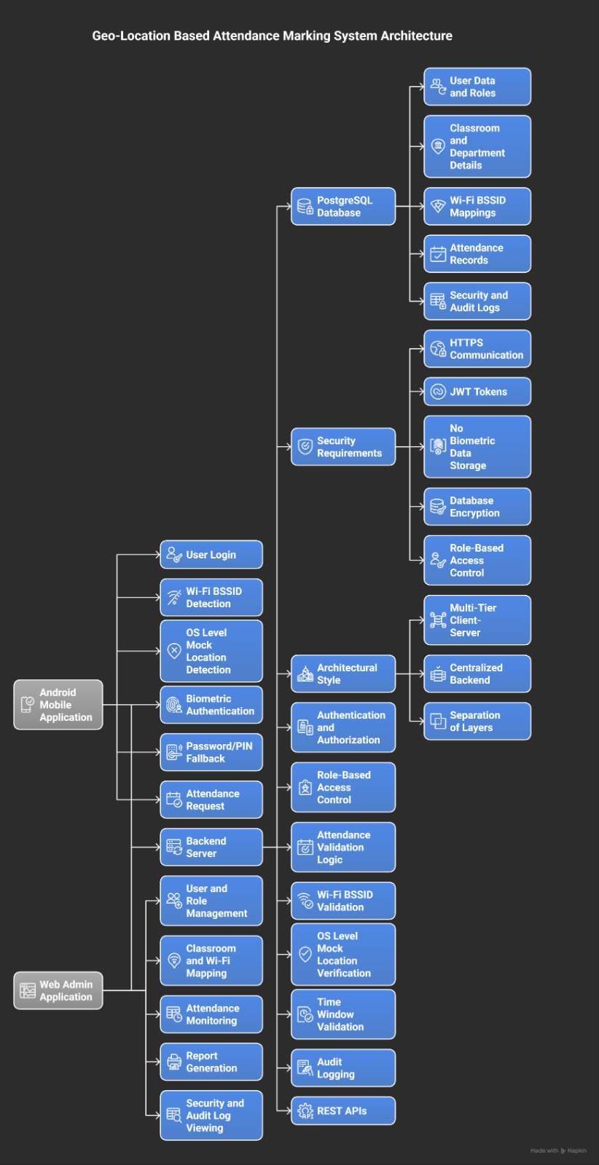
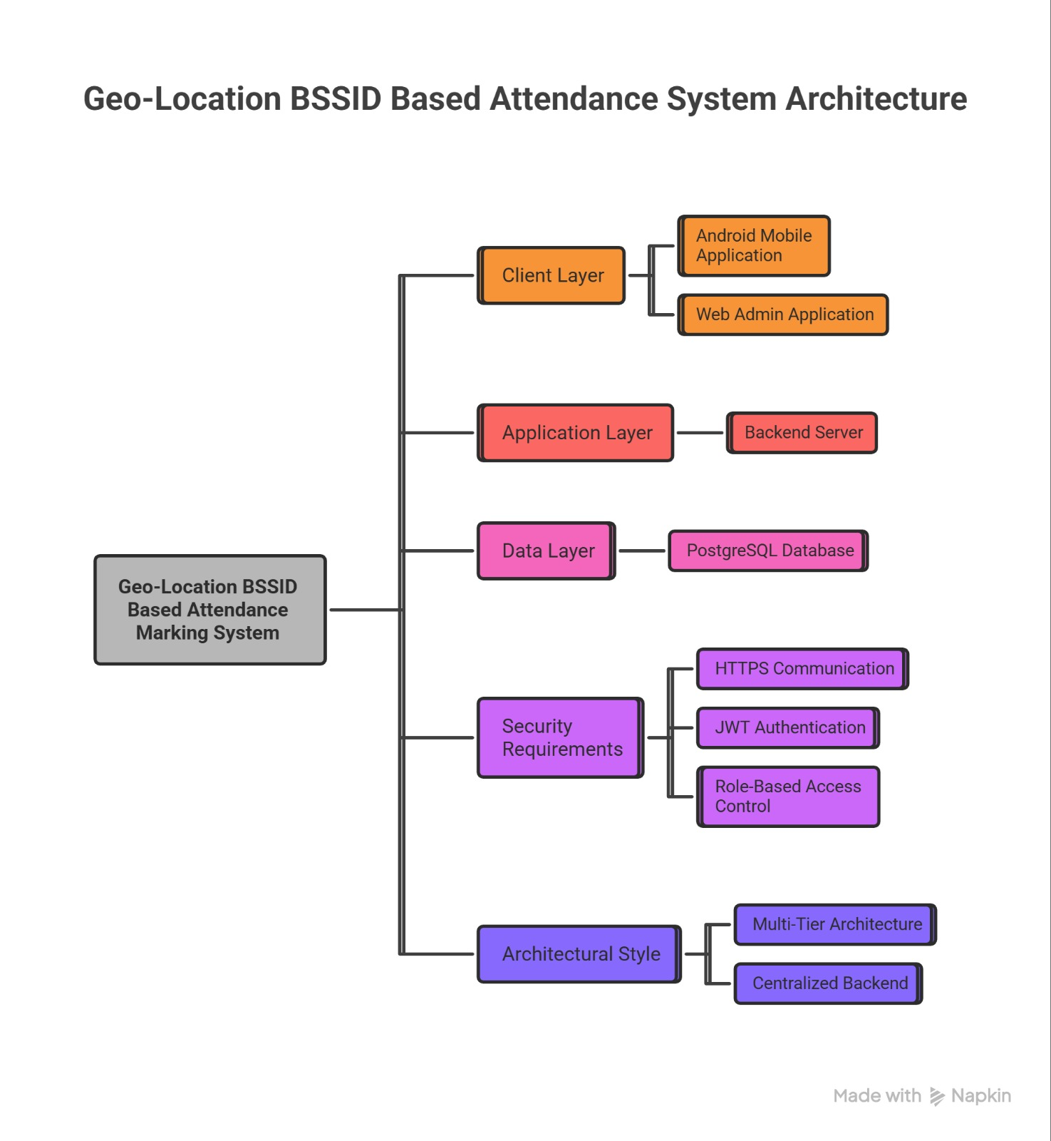
Architecture Diagram

Slide 15
Software Details
Technology Stack Components:
Cross-Platform Framework: Flutter or React Native
Backend Framework: Node.js (Express), Python (Django/Flask), or Java (Spring)
Database: PostgreSQL or MongoDB
Cloud Platform: AWS, Azure, or Google Cloud Platform (GCP)
Biometric SDKs:
Device-level: Android Biometric Prompt, iOS Local Authentication
Server-side: Open-source Biometric SDK for multimodal matching
Security Protocols: TLS/HTTPS, OAuth2/JWT, AES-256 encryption

Slide 16
Git Hub Link
LINK:
Multifactor based Geolocation Attendance System GIT.

Slide 17


